Slide 1




ARTIFICIAL INTELLIGENCE II Prof.Shikha Bansal,Assistant Professor IT & Computer Science

Slide 2


CHAPTER-4
Natural Language Processing

Slide 3
What is NLP?
Natural Language Processing (NLP) is a subfield of computer science and artificial intelligence that deals with the interaction between computers and human languages. The primary goal of NLP is to enable computers to understand, interpret, and generate natural language, the way humans do.
NLP involves a variety of techniques, including computational linguistics, machine learning, and statistical modeling. These techniques are used to analyze, understand, and manipulate human language data, including text, speech, and other forms of communication.

Slide 4
What is NLP?
Some of the main applications of NLP include language translation, speech recognition, sentiment analysis, text classification, and information retrieval. NLP is used in a wide range of industries, including finance, healthcare, education, and entertainment, to name a few.
Overall, NLP is a rapidly evolving field that is driving new advances in computer science and artificial intelligence, and has the potential to transform the way we interact with technology in our daily lives.

Slide 5
What is NLP?
NLP has a wide range of applications, including sentiment analysis, machine translation, text summarization, chat bots, and more. Some common tasks in NLP include:
Text Classification: Classifying text into different categories based on their content, such as spam filtering, sentiment analysis, and topic modeling.
Named Entity Recognition (NER): Identifying and categorizing named entities in text, such as people, organizations, and locations.
Part-of-Speech (POS) Tagging: Assigning a part of speech to each word in a
sentence, such as noun, verb, adjective, and adverb.
Sentiment Analysis: Analyzing the sentiment of a piece of text, such as positive,
negative, or neutral.
Machine Translation: Translating text from one language to another.

Slide 6
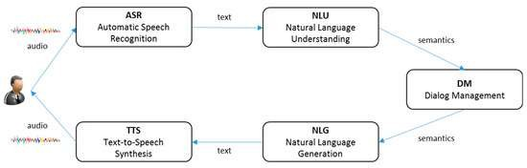
What is NLP?
Process Of NLP

Slide 7
Advantages of Natural Language Processing:
Improves human-computer interaction: NLP enables computers to understand and respond to human languages, which improves the overall user experience and makes it easier for people to interact with computers.
Automates repetitive tasks: NLP techniques can be used to automate repetitive tasks, such as text summarization, sentiment analysis, and language translation, which can save time and increase efficiency.
Enables new applications: NLP enables the development of new applications, such as virtual assistants, chatbots, and question answering systems, that can improve customer service, provide information, and more.

Slide 8
Advantages of Natural Language Processing:
Improves decision-making: NLP techniques can be used to extract insights from large amounts of unstructured data, such as social media posts and customer feedback, which can improve decision-making in various industries.
Improves accessibility: NLP can be used to make technology more accessible, such as by providing text-to-speech and speech-to-text capabilities for people with disabilities.
Facilitates multilingual communication: NLP techniques can be used to translate and analyze text in different languages, which can facilitate communication between people who speak different languages.

Slide 9
Advantages of Natural Language Processing:
Improves information retrieval: NLP can be used to extract information from large amounts of data, such as search engine results, to improve information retrieval and provide more relevant results.
Enables sentiment analysis: NLP techniques can be used to analyze the sentiment of text, such as social media posts and customer reviews, which can help businesses understand how customers feel about their products and services.
Improves content creation: NLP can be used to generate content, such as automated article writing, which can save time and resources for businesses and content creators.

Slide 10
Advantages of Natural Language Processing:
Supports data analytics: NLP can be used to extract insights from text data, which
can support data analytics and improve decision-making in various industries.
Enhances natural language understanding: NLP research and development can lead to improved natural language understanding, which can benefit various industries and applications.

Slide 11
Disadvantages of Natural Language Processing:
Limited understanding of context: NLP systems have a limited understanding of
context, which can lead to misinterpretations or errors in the output.
Requires large amounts of data: NLP systems require large amounts of data to train and improve their performance, which can be expensive and time- consuming to collect.
Limited ability to understand idioms and sarcasm: NLP systems have a limited ability to understand idioms, sarcasm, and other forms of figurative language, which can lead to misinterpretations or errors in the output.
Limited ability to understand emotions: NLP systems have a limited ability to understand emotions and tone of voice, which can lead to misinterpretations or errors in the output.

Slide 12
Disadvantages of Natural Language Processing:
Difficulty with multi-lingual processing: NLP systems may struggle to accurately process multiple languages, especially if they are vastly different in grammar or structure.
Dependency on language resources: NLP systems heavily rely on language resources, such as dictionaries and corpora, which may not always be available or accurate for certain languages or domains.
Difficulty with rare or ambiguous words: NLP systems may struggle to accurately
process rare or ambiguous words, which can lead to errors in the output.

Slide 13
Disadvantages of Natural Language Processing:
Lack of creativity: NLP systems are limited to processing and generating output based on patterns and rules, and may lack the creativity and spontaneity of human language use.
Ethical considerations: NLP systems may perpetuate biases and stereotypes, and there are ethical concerns around the use of NLP in areas such as surveillance and automated decision-making.

Slide 14
Important points:
Preprocessing: Before applying NLP techniques, it is essential to preprocess the text data
by cleaning, tokenizing, and normalizing it.
Feature Extraction: Feature extraction is the process of representing the text data as a set
of features that can be used in machine learning models.
Word Embeddings: Word embeddings are a type of feature representation that captures the semantic meaning of words in a high-dimensional space.
Neural Networks: Deep learning models, such as neural networks, have shown promising results in NLP tasks, such as language modeling, sentiment analysis, and machine translation.
Evaluation Metrics: It is important to use appropriate evaluation metrics for NLP tasks, such as accuracy, precision, recall, F1 score, and perplexity.

Slide 15
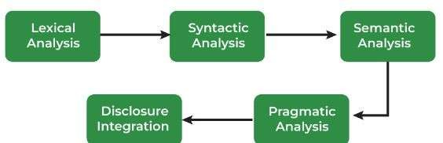
Implementation Phases:
The process of Natural Language understanding comprises of five analytical
phases. These Phases are:
Morphological analysis or Lexical analysis
Syntactic analysis
Semantic analysis
Pragmatic analysis
Discourse analysis
or Disclousure integration
All these phases have their own desired boundaries, but these boundaries are not completely simple to comprehend. They occasionally follow a proper sequence, or sometimes all at once. When one process enrols in a sequence, this process may request for assistance to another one.

Slide 16
Morphological Analysis:
While performing the morphological analysis, each particular word is analyzed. Non-word tokens such as punctuation are removed from the words. Hence the remaining words are assigned categories. For instance, Ram’s iPhone cannot convert the video from .mkv to
.mp4.
In Morphological analysis, word by word the sentence is analyzed.
So here, Ram is a proper noun, Ram’s is assigned as possessive suffix and .mkv and .mp4 is assigned as a file extension.

Slide 17
Morphological Analysis:
Each word is assigned a syntactic category. The file extensions are also identified present in the sentence which is behaving as an adjective in the above example. In the above example, the possessive suffix is also identified. This is a very important step as the judgement of prefixes and suffixes will depend on a syntactic category for the word.
For example, swims and swim’s are different. One makes it plural, while the other makes it a third-person singular verb. If the prefix or suffix is incorrectly interpreted then the meaning and understanding of the sentence are completely changed. The interpretation assigns a category to the word. Hence, discard the uncertainty from the word.

Slide 18
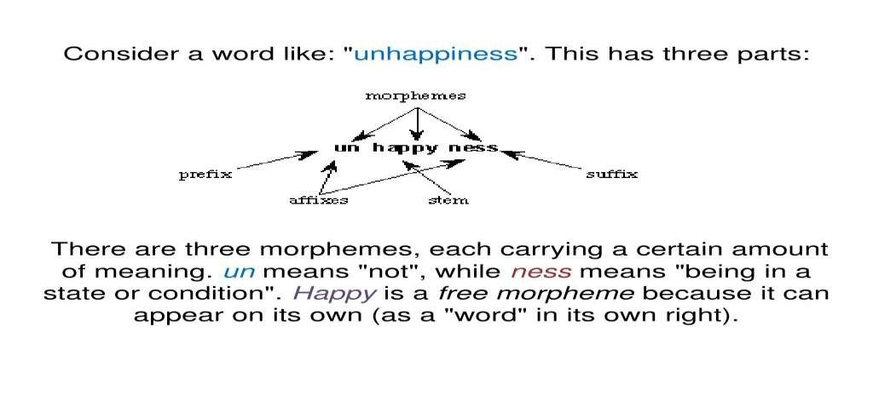

Example of Morphological Analysis:

Slide 19
Syntactic Analysis:
There are different rules for different languages. Violation of these rules will give a syntax error. Here the sentence is transformed into the structure that represents a correlation between the words. This correlation might violate the rules occasionally. The syntax represents the set of rules that the official language will have to follow.
For example, “To the movies, we are going.” Will give a syntax error. The syntactic analysis uses the results given by morphological analysis to develop the description of the sentence. The sentence which is divided into categories given by the morphological process is aligned into a defined structure. This process is called parsing.

Slide 20
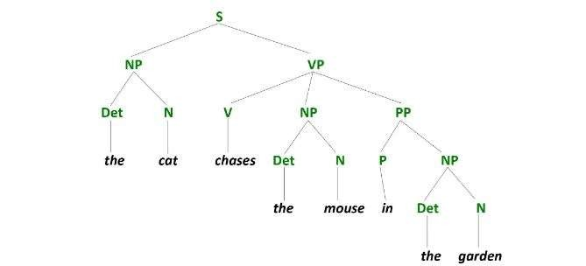
Syntactic Analysis:
For example, the cat chases the mouse in the garden, would be represented as:
Parse Tree

Slide 21
Syntactic Analysis:
Here the sentence is broken down according to the categories. Then it is described in a hierarchical structure with nodes as sentence units. These parse trees are parsed while the syntax analysis run and if any error arises the processing stops and it displays syntax error. The parsing can be top-down or bottom-up.
Top-down: Starts with the first symbol and parse the sentence according to the grammar
rules until each of the terminals in the sentence is parsed.
Bottom-up: Starts with the sentence which is to be parsed and apply all the rules backwards till the first symbol is reached.

Slide 22
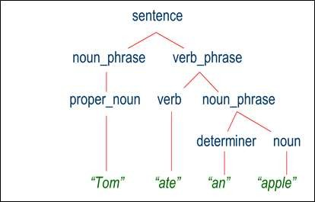
Parse Tree:
Syntax Tree or Parse tree:
A Syntax tree or a parse tree is a tree representation of different syntactic categories of a sentence. It helps us to understand the syntactical structure of a sentence.
Example:
The syntax tree for the sentence given below is as follows:
Tom ate an apple.

Slide 23
Levels of Syntactic Analysis:
Part-of-speech (POS) tagging
This is the first level of syntactic analysis. Part-of-speech tagging is a vital part of syntactic analysis and involves tagging words in the sentence as verbs, adverbs, nouns, adjectives, prepositions, etc.
Part-of-speech tagging helps us understand the meaning of the sentence. All other parsing
techniques make use of part-of-speech tags. Ex- Camera, Building, etc.
Constituency parsing
Constituency parsing involves the segregation of words from a sentence into groups, on
the basis of their grammatical role in the sentence.
Noun Phrases, Verb Phrases, and Prepositional Phrases are the most common constituencies, while other constituencies like Adverb phrases and Nominals also exist. Ex- Showcase, Danceclass,etc.

Slide 24
Levels of Syntactic Analysis:
3. Dependency parsing
Dependency parsing is widely used in free-word-order languages. In dependency parsing, dependencies are formed between the words themselves.
When two words have dependencies between them, one word is the head while the
other one is the child or the dependent.
Ex- ing
Go + ing = Going Eat + ing = Eating

Slide 25
Semantic Analysis:
The semantic analysis looks after the meaning. It allocates the meaning to all the structures built by the syntactic analyzer. Then every syntactic structure and the objects are mapped together into the task domain. If mapping is possible the structure is sent, if not then it is rejected. For example, “hot ice-cream” will give a semantic error. During semantic analysis two main operations are executed:
First, each separate word will be mapped with appropriate objects in the database. The dictionary meaning of every word will be found. A word might have more than one meaning.
Secondly, all the meanings of each different word will be integrated to find a proper correlation between the word structures. This process of determining the correct meaning is called lexical disambiguation. It is done by associating each word with the context.

Slide 26
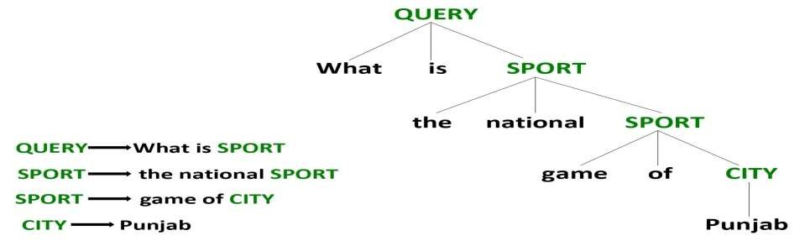
Semantic Analysis:
This process defined above can be used to determine the partial meaning of a sentence. However semantic and syntax are two completely contrasting concepts. It might be possible that a syntactically correct sentence is semantically incorrect.
For example, “A rock smelled the colour nine.” It is syntactically correct as it obeys all the rules of English, but is semantically incorrect. The semantic analysis verifies that a sentence is abiding by the rules and creates correct information.
Example of semantic analysis

Slide 27
Elements of Semantic Analysis:
Homonymy
It may be defined as the words having same spelling or same form but having different and unrelated meaning. For example, the word “Bat” is a homonymy word because bat can be an implement to hit a ball or bat is a nocturnal flying mammal also.
Hyponymy & Hypernymy
It may be defined as the relationship between a generic term and instances of that generic term. Here the generic term is called hypernym and its instances are called hyponyms. For example, the word color is hypernym and the color blue, yellow etc. are hyponyms.
Hyponymy is a transitive relation: if X is a hyponym of Y, and Y is a hyponym of Z, then X is a hyponym of Z.^{[8]} For example, violet is a hyponym of purple and purple is a hyponym of color; therefore violet is a hyponym of color.
A word can be both a hypernym and a hyponym: for example purple is a hyponym of color but
itself is a hypernym of the broad spectrum of shades of purple between the range of crimson and violet.

Slide 28
Elements of Semantic Analysis:
Hypernymy is a term whose meaning includes the meaning of other words, its a broad superordinate label that applies to many other members of set. It describes the more broad terms or we can say that more abstract terms. for e.g hypernym of labrador, german sheperd is dog.
Meronymy- meronym is a word that denotes a constituent part or a member of
something. For example, apple is a meronym of apple tree (sometimes written as apple<apple tree). This part-to-whole relationship is called meronymy.
a 'tire' is part of a 'car'
a 'wheel' is made from 'rubber'"​

Slide 29
Elements of Semantic Analysis:
Synonymy: When two or more lexical terms that might be spelt distinctly have the same or similar meaning, they are called Synonymy. For example: (Job, Occupation), (Large, Big), (Stop, Halt).
Antonymy: Antonymy refers to a pair of lexical terms that have contrasting meanings – they are symmetric to a semantic axis. For example: (Day, Night), (Hot, Cold), (Large, Small).
The basic units of semantic systems are explained below:
Entity: An entity refers to a particular unit or individual in specific such as a person or a
location. For example Parul University, Delhi, etc.
Concept: A Concept may be understood as a generalization of entities. It refers to a broad class
of individual units. For example Learning Portals, City, Students.
Relations: Relations help establish relationships between various entities and concepts. For
example: ‘PU is a Uiniversity. ‘, ‘Delhi is a City.’, etc.
Predicate: Predicates represent the verb structures of the sentences.

Slide 30
Pragmatic Analysis:
The pragmatic analysis means handling the situation in a much more practical or realistic manner than using a theoretical approach. As we know that a sentence can have different meanings in various situations. For example,
The average is 18.
The average is 18. (average may be of sequence)
The average is 18. (average may be of a vehicle)
The average is 18. (average may be of a mathematical term)
We can see that for the same input there can be different perceptions. To interpret the meaning of the sentence we need to understand the situation. To tackle such problems we use pragmatic analysis. The pragmatic analysis tends to make the understanding of the language much more clear and easy to interpret.

Slide 31
Discourse Analysis:
While processing a language there can arise one major ambiguity known as referential ambiguity. Referential ambiguity is the ambiguity that can arise when a reference to a word cannot be determined.
For example,
Ram won the race. Mohan ate half of a pizza. He liked it.
In the above example, “He” can be Ram or Mohan. This creates an ambiguity. The word “He” shows dependency on both sentences. This is known as disclosure integration. It means when an individual sentence relies upon the sentence that comes before it. Like in the above example the third sentence relies upon the sentence before it. Hence the goal of this model is to remove referential ambiguity.

Slide 32
Implementation:
The five phases discussed above for Language processing are required to follow an order. Each phase takes its input from the previous phase’s output and sends it along to the next phase for processing. While this process input can get rejected half-way if it does not follow the rules defining it for the next phase.
Also, More than one phase can start processing together. This may happen due to ambiguity between the phases.
For instance, consider the sentence
Is the electric vehicle Tesla car?
The above sentence has four noun phrases at the end which will be required to form noun
phrases to give the sentence of the form:
“Is the A B?” where A & B represents the noun phrases we require. While syntax analysis there will be the following choices available:

Slide 33
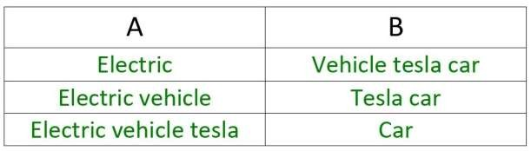
Implementation:
While performing the syntactic analysis all of these choices look applicable, but to get the correct phrases we require to analyze the semantics. When we apply semantic analysis
the only options making sense are “electric vehicle” and “tesla car”. Hence, we can say
that these processes are separated but they can communicate in different ways.
Language is a structure which follows different rules. Natural Language processes the written form of language concerning the rules developed. The main focus is to erase ambiguity & uncertainty from the language to make the communication much easier.

Slide 34
Spell Checking:
Spelling Correction is a very important task in Natural Language Processing. It is used in various tasks like search engines, sentiment analysis, text summarization, etc. As the name suggests, we try to detect and correct spelling errors in spelling correction.
In real-world NLP tasks, we often deal with data having typos, and their spelling correction comes to the rescue to improve model performance. For example, if we want to search apple and type “aple,” we will wish that the search engine suggests “apple” instead of giving no results.

Slide 35
Spell Checking:
What is spelling correction in NLP?
Spelling correction in NLP refers to detecting incorrect spellings and then correcting them.
How does autocorrect work in NLP?
Autocorrect tries first to find whether a given word is correct or not. It does so by checking in the dictionary. If the word exists, it means that it is correct; otherwise, it is not. If the word isn’t right, it tries to find other close options and finds the best-suited word.
How do you correct spelling in Python?
We can correct spellings in Python using SymSpell, Norvig’s method, etc.
Is autocorrect artificial intelligence?
Yes, auto correction is artificial intelligence as it uses the intelligence of machines to correct spelling.
Is spelling important in Python?
Yes, spelling is very important in Python as we can get correct and accurate results with correct spellings. With incorrect spelling, the accuracy of tasks like search engines can decrease due to their ambiguous nature.

Slide 36
www.paruluniversity.ac.in

